Slide 1
Course ID: CSE - 471
Course Title: System Analysis and Design
Course Coordinator: Dr. Muhammad Iqbal Hossain
Associate professor Department of Computer Science & Engineering BRAC University.

Slide 2
Resources
Text book: System analysis and design 5th edition, Dennis, Wixom, Roth.
Presentation slides
Other resources will be shared between the lecture.

Slide 3
Lecture 1
Segment 1:What is System analysis and design
Segment 2: Software lifecycle
Segment 3: DevOps
Segment 4: DevOps (cont.)
Segment 5: Project Team Roles and Skills

Slide 4
Segment 1
What is System analysis and design

Slide 5
Introduction
The systems development life cycle (SDLC) is the process of determining how an information system (IS) can support business needs, designing the system, building it, and delivering it to users
The systems analyst plays a key role in the SDLC, analyzing the business situation, identifying opportunities for improvements, and designing an IS to implement the improvements
The primary goal of the system analyst is to create value for the organization, which for most companies means increasing profits
Systems analysts do things and challenge the current way that an organization works.

Slide 6
Information System
Information systems are software applications which manage large amounts of data, share information etc.
Most of the software out there is information systems software,
written in languages such as Java, C++, .NET and the like.

Slide 7
Components of IS
Hardware- these are the devices like the monitor, processor, printer and keyboard, all of which work together to accept, process, show data and information.
Software- are the programs that allow the hardware to process the data.
Databases- are the gathering of associated files or tables containing related data.
Networks- are a connecting system that allows diverse computers to distribute resources.
Procedures- are the commands for combining the components above to process information and produce the preferred output.
Notes:
Facebook processes 2.5 billion pieces of content and 500+ terabytes of data each day. It’s pulling in 2.7 billion Like actions and 300 million photos per day, and it scans roughly 105 terabytes of data each half hour.
Youtube: 100 million videos watched per day, 65,000 videos added each day, 60% of all videos watched online, At least 45 terabytes of videos

Slide 8
Software Horror Stories
Bank of America spent $23,000,000 on a 5-year project to develop a new accounting system. Spent over $60,000,000 trying to make new system work, finally abandoned it. Loss of business estimated in excess of $1,000,000,000
The B1 Bomber required an additional $1,000,000,000 to improve its air defense software, but the software still isn’t working to specification
Ariane 5, Flight 501 The loss of a $500,000,000 spacecraft was ultimately attributed to errors in requirements, specifications and inadequate software reuse practices.
Notes:
23,000,000 = twenty three million
1,000,000,000 = one billion
500,000,000 = five hundred million

Slide 9
The Bad News
30% of large IT projects are cancelled before completion
50% of IT projects are over-budget by more than 200%
The majority of completed projects deliver 60% or less of prescribed functionality
Many delivered information systems are under-used because they don’t meet user needs and/or expectations
Legacy systems are a serious and growing bottleneck to organizational evolution

Slide 10
Why is this Course Important?
Most errors (54%) are detected after coding and testing.
Almost half of all errors in software (45%) are in requirements and design.
Most errors made during requirements analysis are non-clerical (77%)
Requirements errors can cost up to 100 times more to fix than implementation errors
if they are not caught early on.
Need to do requirements and design right!

Slide 11
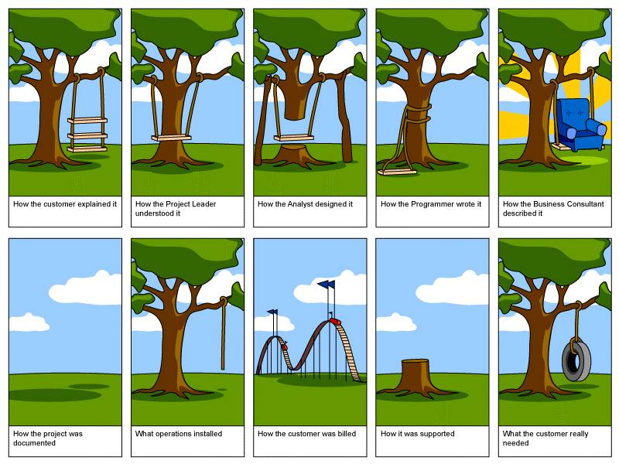

Slide 12
Key Ideas
Many failed systems were abandoned because analysts tried to build wonderful systems without understanding the organization.
The primary goal is to create value for the organization.

Slide 13
Key Ideas
Systems analyst is a key person
analyzing the business
identifying opportunities for improvement
designing information systems to implement these ideas.

Slide 14
The Systems Analyst
The systems analyst works closely with all project team members so that the team develops the right system in an effective way
Systems analysts must understand how to apply technology to solve business problems
Systems analysts serve as change agents who identify the organizational improvements needed, design systems to implement those changes, and train and motivate others to use the systems

Slide 15
Systems Analyst Skills
Analysts must have the technical skills to understand the organization’s existing technical environment, the new system’s technology foundation, and the way in which both can be fit into an integrated technical solution
Business skills are required to understand how IT can be applied to business processes and to ensure that IT delivers real business value
Analysts are continuous problem solvers at both the project and the organizational level, and they put their analytical skills to the test regularly

Slide 16
What is System Analysis?
The collection of notations, methodologies and tools used to gather details and analyze a problem situation prior to information system design and implementation
Systems analysis (or, requirements analysis) must ensure that the proposed information system meets user needs, can be delivered on time, and can be updated inexpensively.
Problems in "getting the systems analysis right", such as ill-defined situations, ambiguities, inconsistencies, mixing requirements with design

Slide 17
Need for Systems Analysis?
Remember, finding and fixing a fault after software delivery is 100x more expensive than finding and fixing it during systems analysis or early design phases
End of Segment 1

Slide 18
Segment 2 Software lifecycle

Slide 19
Major Attributes of the Lifecycle
The project
Moves systematically through phases where each phase has a standard set of outputs
Produces project deliverables
Uses deliverables in implementation
Results in actual information system
Uses gradual refinement

Slide 20
Project Phases
Planning
Why build the system?
Analysis
Who, what, when, where will the system be?
Design
How will the system work?
Implementation
System delivery

Slide 21
Planning
Identifying business value
Analyze feasibility
Develop work plan
Staff the project
Control and direct project

Slide 22
Analysis Phase
Determine analysis strategy
Study existing system and its problems
Collect and analyze requirements
Develop new system concept
Describe new system with analysis models
Prepare and present system proposal
Summarize results of the Analysis Phase
Go/No Go decision made by sponsor and steering committee

Slide 23
Design Phase
Determine design strategy
Build / buy / outsource
Design system components
Architecture, interface, database, programs
Assemble design elements into system specification
Present to steering committee
Go /no go decision before entering final phase

Slide 24
Implementation Phase
System construction
Programming and testing
System installation
Training
Conversion to new system
On-going system support

Slide 25
Processes and Deliverables
Process
Product
Project Plan
System Proposal
System
Specification
New System and
Maintenance Plan
Planning
Analysis
Design
Implementation

Slide 26
What is a Methodology?
A formalized approach or series of steps to implement SDLC
Methodology categories:
Process-centered
Data-centered
Object-oriented

Slide 27
Need for methodology
Writing code without a well-thought-out system request may work for small programs, but rarely works for large ones.
Need to have a good design from the requirements before moving on to implementation.

Slide 28
Systems development methodologies
Structured Design
Waterfall Development
Parallel Development
Rapid Application Development (RAD)
Phased Development
Prototyping
Agile Development
Extreme Programming
Devops
End of Segment 2

Slide 29
Segment 3 DevOps

Slide 30
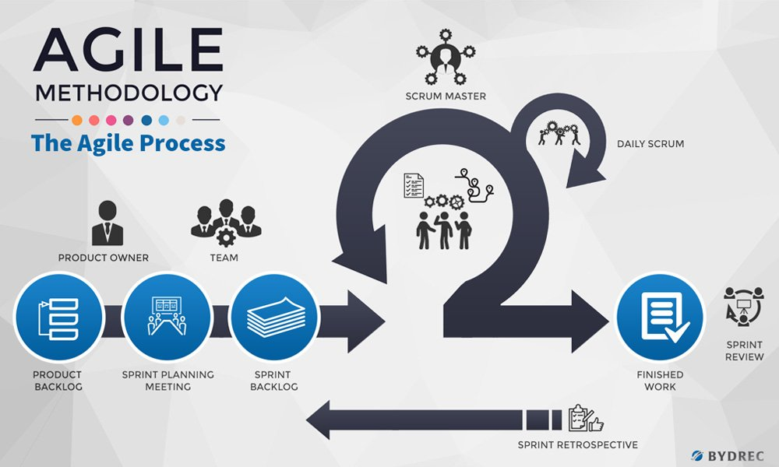
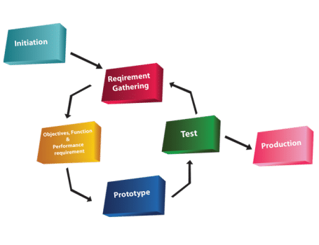
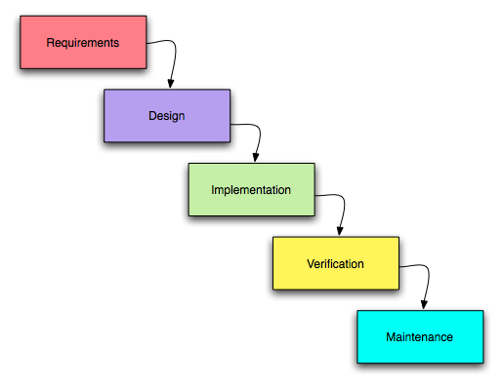
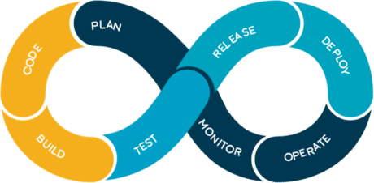
Current SDLC methodology
Waterfall
prototyping
Agile
DevOps

Slide 31

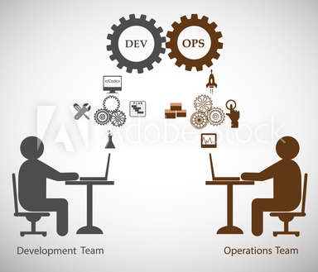


What is DevOps?
Notes:
Devops is not a tool or a team, it is the process or a methodology of using various tools to solve the problems between Developers and Operations team, hence the term “Dev-Ops”
The term “DevOps” was introduced by Patrick Debois in 2007.
DevOps is a fusion of terms–software development and information technology operations. It’s possible to gain insight over your business’ entire pipeline when incorporating DevOps within the way you’re running operations. By doing so, you’re also allowing your teams to work more efficiently with fewer redundancies.

Slide 32
Why DevOps?
Before DevOps, operation and development teams were working in an isolated environment.
Testing and Deployment activities mostly were performed in an isolated manner after design-build step, and they took more time than actual project completion time.
Team members usually spend a large amount of time in deploying, testing, designing, and building the projects

Slide 33
Why DevOps?
Human production errors were deployed during manual code conduction.
Operations and coding teams generally had different timelines and did not have proper synchronization that results in further delay.
To avoid the hassles mentioned above and non-collaborative performance measures, there was an urgent need for robust IT technology like DevOps to satisfy business owners and stakeholders.

Slide 34
Current relation among Development and Operation team
The development team worked on the software, developing it and making sure that the code worked perfectly.
After hours of hardwork and a lot of trial and error, the team releases a code which has to be executed by the Operations team which is responsible for the release and operation of the code.
The operations team will be checking the application and its performance and reporting back any bugs, if present.

Slide 35
What DevOps can do?
To bridge this gap, Development(‘Dev’) team and Operations (‘Ops’) team collaborated giving rise to DevOps.
The Development team encapsulated their code in a container which is a lightweight software environment.
When the developers were done with their work, they would simply pass on this container along with the code to the operations team. The Ops will run this container, along with the code, and it worked as expected!
End of Segment 3

Slide 36
Segment 4 DevOps (cont.)

Slide 37
Steps of DevOps

Slide 38
Steps of DevOps
Code: The first step in the DevOps life cycle is coding, where developers build the code on any platform
Build: Developers build the version of their program in any extension depending upon the language they are using
Test: For DevOps to be successful, the testing process must be automated using any automation tool like Selenium
Release: A process for managing, planning, scheduling, and controlling the build in different environments after testing and before deployment

Slide 39
Steps of DevOps
Deploy: This phase gets all artifacts/code files of the application ready and deploys/executes them on the server
Operate: The application is run after its deployment, where clients use it in real-world scenarios.
Monitor: This phase helps in providing crucial information that basically helps ensure service uptime and optimal performance
Plan: The planning stage gathers information from the monitoring stage and, as per feedback, implements the changes for better performance

Slide 40
Everything should be Continuous
Continuous Development
Continuous Testing
Continuous Integration
Continuous Deployment
Continuous Monitoring

Slide 41
The advantage of DevOps
Reduced chance of product failure
Improved flexibility and support.
Faster time to market.
Better team efficiency.
Clear product vision within the team.

Slide 42
DevOps Challenges
Difficulties with Integration
Automated Testing
Relatively High Costs
Toolset Choice
Lack of Talent

Slide 43
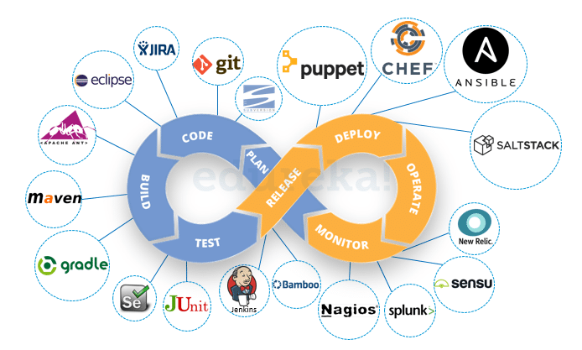

Slide 44
Segment 5 Project Team Roles and Skills

Slide 45
Information Systems Roles
Business analyst
System analyst
Infrastructure analyst
Change management analyst
Project manager

Slide 46
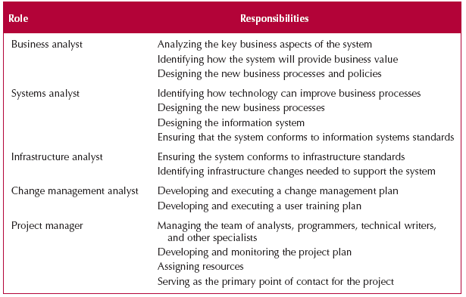
Project Team Roles

Slide 47
Summary -- Part 1
The Systems Development Life Cycle consists of four stages: Planning, Analysis, Design, and Implementation
The major development methodologies:
Structured design
the waterfall method
Parallel development
RAD development
Prototyping (regular and throwaway)
Agile development
XP streamline SDLC
DevOps

Slide 48
Summary -- Part 2
There are five major team roles: business analyst, systems analyst, infrastructure analyst, change management analyst and project manager.

